Slide 1

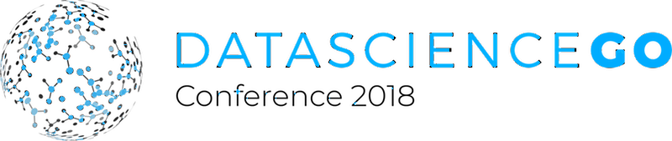
HACK
A
THON
Nov 9th-10th
Team Work
Coding
Networking
Fun
Many great prizes to be won:
Best Model
Best Visualization
Most Helpful Person

